Slide 1
What Is Information Security Awareness ?
Ensure employees are aware of :
The importance of protecting sensitive information
What they should do to handle information securely
Risks of mishandling information
REF: PCI Best Practices For Implementing Security Awareness
https://www.pcisecuritystandards.org/documents/

Slide 2
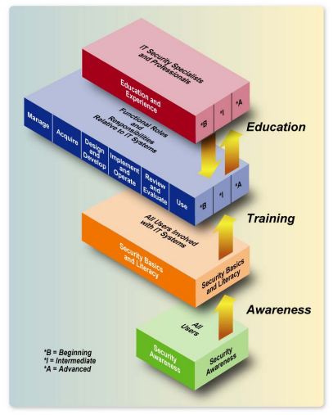
What Is Information Security Awareness ?

Slide 3
What Is Information Security Awareness ?
NIST Special Publication 800-50 (Building An IT Security Awareness & Training Program)
Awareness
Training
Education

Slide 4
What Is Information Security Awareness ?
Awareness:
Awareness is not training
Purpose of awareness is simply to focus attention on security
Change behavior or reinforce good security practices
REF: NIST SP800-50, PAGE 8

Slide 5
What Is Information Security Awareness ?
Training:
“Strives to produce relevant and needed security skills and competencies”
Seeks to teach skills
E.g. IT Security course for system administrators covering all security aspects
REF: NIST SP800-50, PAGE 9

Slide 6
What Is Information Security Awareness ?
Education:
Integrates all of the skills and competencies into a common body of knowledge
E.g. a degree program

Slide 7
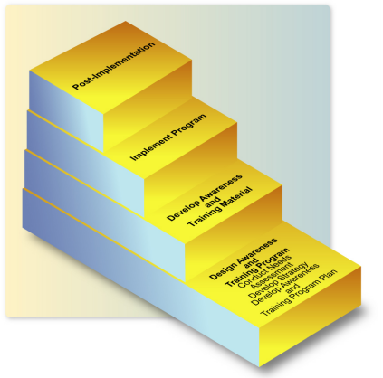
What Is Information Security Awareness ?
NIST-SP-800-50
IMPLEMENTATION STEPS

Slide 8
What Is Information Security Awareness ?
Don’ts:
Share your password
Click on suspicious email links
Install unlicensed software on your PC
Do’s:
Logout when getting up from your system
Report security incidents

